Slide 1
Unit IV : Topic: Tidy Data with tidyr Sub.Topic: Introduction
A consistent way to organize data in R, an organization called tidy data
tidyr package.
library(tidyverse)
Library(tidyr)

Slide 2
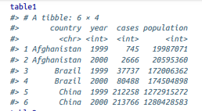
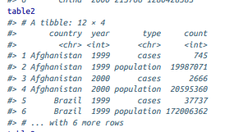
Sub. Topic: Tidy Data
The following example shows the same data organized in four different ways.
Each dataset shows the same values of four variables, country, year, population, and cases, but each dataset organizes the values in a different way

Slide 3
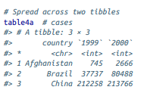
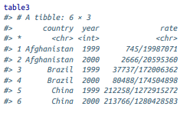
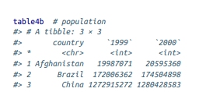
Sub. Topic: Tidy Data

Slide 4
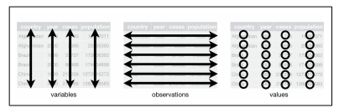
Sub. Topic: Tidy Data
One dataset, the tidy dataset, will be much easier to work with inside the tidyverse.
There are three interrelated rules which make a dataset tidy:
1. Each variable must have its own column.
2. Each observation must have its own row.
3. Each value must have its own cell.
The figure shows the rules visually

Slide 5
Sub. Topic: Tidy Data
These three rules are interrelated because it’s impossible to only satisfy two of the three.
That interrelationship leads to an even simpler set of practical instructions:
1. Put each dataset in a tibble.
2. Put each variable in a column.
In this example, only table1 is tidy. It’s the only representation where each column is a variable.

Slide 6
Sub. Topic: Tidy Data
Why ensure that your data is tidy?
There are two main advantages:
There’s a general advantage to picking one consistent way of storing data.
There’s a specific advantage to placing variables in columns because it allows R’s vectorized nature to shine.

Slide 7
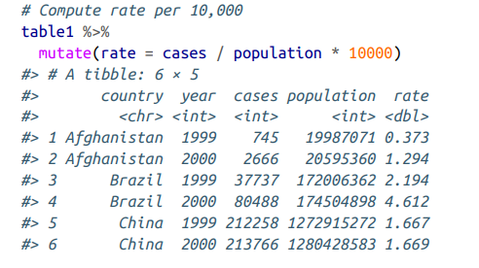
Sub. Topic: Tidy Data
dplyr, ggplot2, and all the other packages in the tidyverse are designed to work with tidy data.
Small examples showing how to work with table1
Compute a new variable rate using existing variables

Slide 8
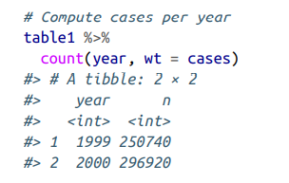
Sub. Topic: Tidy Data
Compute cases per year
library(dplyr)
table1 %>% count(year, wt = cases)
Wt is an argument , it is optional --- if omitted , will count the number of rows If specified, will perform a "weighted" tally by summing the (non-missing) values of variable wt

Slide 9
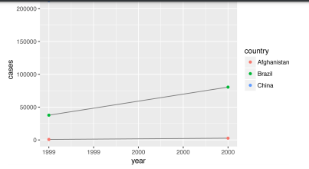
Sub. Topic: Tidy Data
Visualize changes in cases over time
library(ggplot2)
ggplot(table1, aes(year, cases)) +
geom_line(aes(group = country), color = "grey50") + geom_point(aes(color = country))

Slide 10
Tidy data-Exercises- Refer Video 1
1. Using prose, describe how the variables and observations are organized in each of the sample tables.
In table table1, each row represents a (country, year) combination. The columns cases and population contain the values for those variables.
In table2, each row represents a (country, year, variable) combination. The column count contains the values of variables cases and population in separate rows
In table3, each row represents a (country, year) combination. The column rate provides the values of both cases and population in a string formatted like cases / population.
Table 4 is split into two tables, one table for each variable. The table table4a contains the values of cases and table4b contains the values of population. Within each table, each row represents a country, each column represents a year, and the cells are the value of the table’s variable for that country and year

Slide 11
Tidy data-Exercises- Refer Video 1
2. Compute the rate for table2, and table4a + table4b.
You will need to perform four operations:
a. Extract the number of TB cases per country per year.
b. Extract the matching population per country per year.
c. Divide cases by population, and multiply by 10,000.
d. Store back in the appropriate place.
Which representation is easiest to work with? Which is hardest? Why?
Library(dplyr)
Extract the number of TB cases per country per year.
t2_cases <- filter(table2, type == "cases") %>% rename(cases = count) %>% arrange(country, year)

Slide 12
Tidy data-Exercises- Refer Video 1
Extract the matching population per country per year.
t2_population <- filter(table2, type == "population") %>% rename(population = count) %>% arrange(country, year)
Divide cases by population, and multiply by 10000.
t2_cases_by_pop <- tibble( year = t2_cases$year, country = t2_cases$country, cases = t2_cases$cases, population = t2_population$population ) %>% mutate(cases_by_pop= (cases / population) * 10000) %>% select(country, year, cases_by_pop)
Store back in the appropriate place.
t2_cases_by_pop <- t2_cases_by_pop %>% mutate(type = "cases_by_pop") %>% rename(count = cases_by_pop)

Slide 13
Tidy data-Exercises- Refer Video 1
For table4a and table4b, create a new table for cases per capita, name table4c, with country rows and year column
table4c <- tibble( country = table4a$country, `1999` = table4a[["1999"]] / table4b[["1999"]] * 10000, `2000` = table4a[["2000"]] / table4b[["2000"]] * 10000 )
table4a and table4b split the cases and population variables into different tables which made it easy to divide cases by population

Slide 14
Tidy data-Exercises- Refer Video 1
3. Recreate the plot showing change in cases over time using table2 instead of table1. What do you need to do first?
Before creating the plot with change in cases over time, need to filter table to only include rows representing cases of TB.
table2 %>% filter(type == "cases") %>% ggplot(aes(year, count)) + geom_line(aes(group = country), colour = "grey50") + geom_point(aes(colour = country)) +

Slide 15
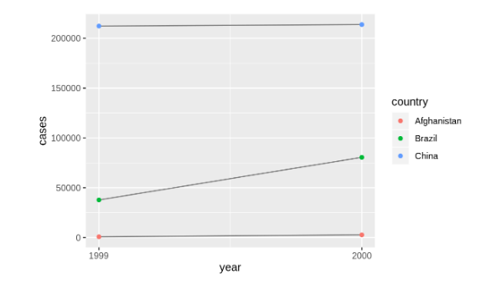
Tidy data-Exercises- Refer Video 1

Slide 16
Sub. Topic: Spreading and Gathering
There are two main reasons for the data become untidy:
Most people aren’t familiar with the principles of tidy data, and it’s hard to derive them yourself unless you spend a lot of time working with data.
Data is often organized to facilitate some use other than analysis. For example, data is often organized to make entry as easy as possible.

Slide 17
Sub. Topic: Spreading and Gathering
To make tidy data
The first step is always to figure out what the variables and observations are
The second step is to resolve one of two common problems:
One variable might be spread across multiple columns.
One observation might be scattered across multiple rows.
To fix these problems, you’ll need the two most important functions in tidyr: gather() and spread().

Slide 18

Sub. Topic: Spreading and Gathering
A common problem is a dataset where some of the column names are not names of variables, but values of a variable
Take table4a; the column names 1999 and 2000 represent values of the year variable, and each row represents two observations, not one:

Slide 19
Sub. Topic: Spreading and Gathering
To tidy a dataset like this, need to gather those columns into a new pair of variables.
The set of columns that represent values, not variables. In this example, those are the columns 1999 and 2000.
The name of the variable whose values form the column names. call that the key, and here it is year.
The name of the variable whose values are spread over the cells. call that value, and here it’s the number of cases.

Slide 20
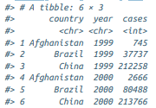
Sub. Topic: Spreading and Gathering
Together those parameters generate the call to gather():
table4a %>% gather(`1999`, `2000`, key = "year", value = "cases")
To tidy table4b in a similar fashion.
table4b %>% gather(`1999`, `2000`, key = "year", value = "population")

Slide 21
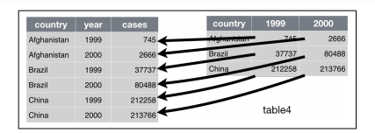
Sub. Topic: Spreading and Gathering
Gathering table4 into a tidy form

Slide 22
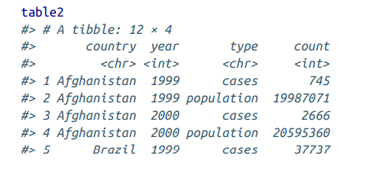
Sub. Topic: Spreading and Gathering
Spreading is the opposite of gathering.
table2—an observation is a country in a year, but each observation is spread across two rows:
To tidy this up, first analyze the representation in a similar way to gather().

Slide 23
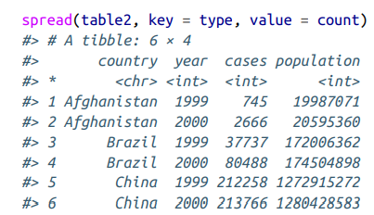
Sub. Topic: Spreading and Gathering
This time, however, need two parameters:
The column that contains variable names, the key column. Here, it’s type.
The column that contains values forms multiple variables, the value column. Here, it’s count.
Once figured that out, can use spread(), as shown programmatically
spread(table2, key = type, value = count)

Slide 24
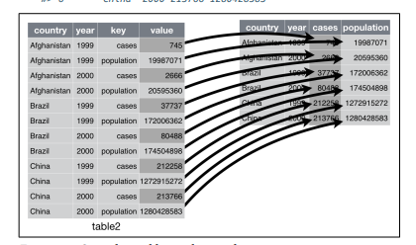
Sub. Topic: Spreading and Gathering
Visual of separating- Spreading table2 makes it tidy

Slide 25
Spreading and Gathering- Exercises-Refer Video2
1. Why are gather() and spread() not perfectly symmetrical? Carefully consider the following example:
stocks <- tibble(
year = c(2015, 2015, 2016, 2016),
half = c( 1, 2, 1, 2),
return = c(1.88, 0.59, 0.92, 0.17) )
stocks %>% spread(year, return) %>%
gather("year", "return", `2015`:`2016`)
(Hint: look at the variable types and think about column names.)
Both spread() and gather() have a convert argument. What does it do?

Slide 26
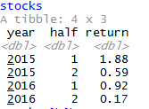
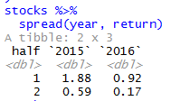
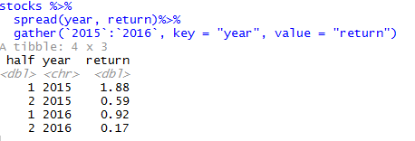
Spreading and Gathering- Exercises-Refer Video2

Slide 27
Spreading and Gathering- Exercises-Refer Video2
The functions spread() and gather() are not perfectly symmetrical because column type information is lost.
When we use gather() on a data frame, it discards the original column types. It has to force all the gathered variables into a single vector with a single type.
If we spread() that data frame, the spread() function does not know the original data types of the variables.
In this example, the column year is numeric.
After running spread() and gather(), the year column is a character vector.
After spread(), the years are column names.
use of gather() will create a column, year, from the column names

Slide 28
Spreading and Gathering- Exercises-Refer Video2
The functions spread() and gather() are almost symmetrical if we use the convert argument. When convert = TRUE, the gather() function will attempt to convert vectors to the appropriate type using type.convert().
stocks %>% spread(key = "year", value = "return") %>% gather(`2015`:`2016`, key = "year", value = "return", convert = TRUE)
Now, year is an integer vector

Slide 29
Spreading and Gathering- Exercises-Refer Video2
2. Why does this code fail?
table4a %>% gather(1999, 2000, key = "year", value = "cases")
The code fails because the column names 1999 and 2000 are not non-syntactic variable names.
When selecting variables from a data frame, tidyverse functions will interpret numbers, like 1999 and 2000, as column numbers.
In this case, gather() tries to select 1999th and 2000th column of the data frame.

Slide 30
Spreading and Gathering- Exercises-Refer Video2
To select the columns 1999 and 2000, you can either surround their names in ` or provide them as strings.
table4a %>% gather(`1999`, `2000`, key = "year", value = "cases")
table4a %>% gather("1999", "2000", key = "year", value = "cases")

Slide 31
Spreading and Gathering- Exercises-Refer Video2
3. Why does spreading this tibble fail? How could you add a new column to fix the problem?
people <- tribble( ~name, ~key, ~value,
#-----------------|--------|------
"Phillip Woods", "age", 45,
"Phillip Woods", "height", 186,
"Phillip Woods", "age", 50,
"Jessica Cordero", "age", 37,
"Jessica Cordero", "height", 156 )
glimpse(people)

Slide 32

Spreading and Gathering- Exercises-Refer Video2

Slide 33
Spreading and Gathering- Exercises-Refer Video2
spread(people, key, value)
Spreading this data frame fails because the name and key columns do not uniquely identify rows. In particular, there are two rows with values for the age of “Phillip Woods”.
Solve the problem by adding a row with a distinct observation count for each combination of name and key.
people2 <- people %>% group_by(name, key) %>% mutate(obs = row_number())

Slide 34
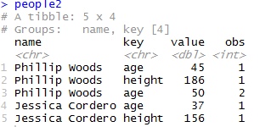
Spreading and Gathering- Exercises-Refer Video2

Slide 35
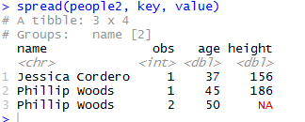
Spreading and Gathering- Exercises-Refer Video2
spread people2 because the combination of name and obs will uniquely identify the spread rows.
spread(people2, key, value)

Slide 36
Spreading and Gathering- Exercises-Refer Video2
4. Tidy the simple tibble below. Do you need to spread or gather it? What are the variables?
preg <- tribble( ~pregnant, ~male, ~female,
"yes", NA, 10,
"no", 20, 12 )

Slide 37
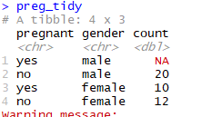
Spreading and Gathering- Exercises-Refer Video2
To tidy the preg tibble, need to use gather().
The variables in this data are: gender (“female”, “male”), pregnant (“yes”, “no”)
count, which is a non-negative integer representing the number of observations.
The observations in this data are unique combinations of gender and pregnancy status.
preg_tidy <- preg %>% gather(male, female, key = “gender", value = "count")
preg_tidy

Slide 38
Sub. Topic: Separating and Pull
When tidy table3, it has a different problem
It has one column (rate) that contains two variables (cases and population).
To fix this problem, need the separate() function.
The complement of separate() is unite(), which use if a single variable is spread across multiple columns

Slide 39
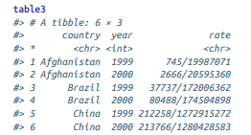
Sub. Topic: Separating and Pull
separate() pulls apart one column into multiple columns, by splitting wherever a separator character appears.
Take table3:

Slide 40
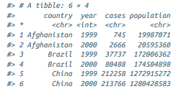
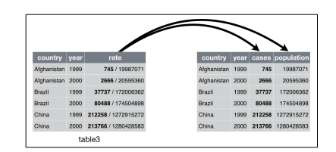
Sub. Topic: Separating and Pull
The rate column contains both cases and population variables, and need to split it into two variables.
separate() takes the name of the column to separate, and the names of the columns to separate into, as shown below
table3 %>% separate(rate, into = c("cases", "population"))

Slide 41
Sub. Topic: Separating and Pull
Split the values of rate at the forward slash characters.
If use a specific character to separate a column, can pass the character to the sep argument of separate().
For example, rewrite the preceding code as:
table3 %>% separate(rate, into = c("cases", "population"), sep = "/")

Slide 42
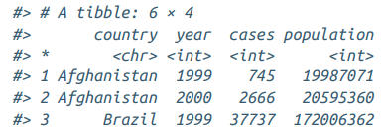
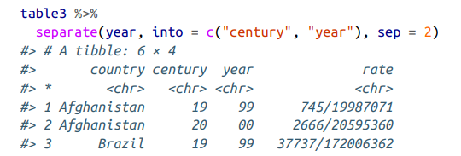
Sub. Topic: Separating and Pull
separate() to try and convert to better types using convert = TRUE:
table3 %>% separate( rate, into = c("cases", "population"), convert = TRUE )
Separate the last two digits of each year.
This makes this data less tidy, but is useful in other cases:
table3 %>% separate(year, into = c("century", "year"), sep = 2)

Slide 43
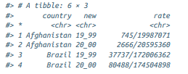
Sub. Topic: Separating and Pull
unite() is the inverse of separate(): it combines multiple columns into a single column.
can use unite() to rejoin the century and year columns that created in the last example
table5 %>% unite(new, century, year)

Slide 44
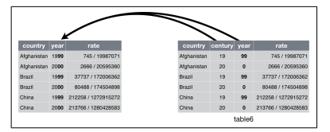
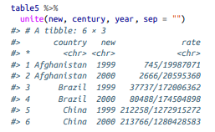
Sub. Topic: Separating and Pull

Slide 45
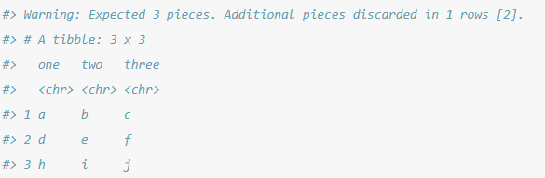
Separating and Pull- Exercises-Refer Video 3
1. What do the extra and fill arguments do in separate()? Experiment with the various options for the following two toy datasets.
tibble(x = c("a,b,c", "d,e,f,g", "h,i,j")) %>% separate(x, c("one", "two", "three"))

Slide 46
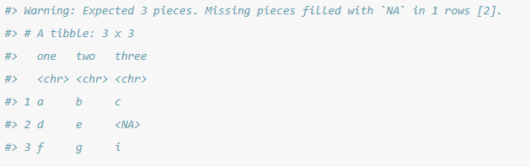
Separating and Pull- Exercises-Refer Video 3
tibble(x = c("a,b,c", "d,e", "f,g,i")) %>% separate(x, c("one", "two", "three"))

Slide 47
Separating and Pull- Exercises-Refer Video 3
The extra argument tells separate() what to do if there are too many pieces, and the fill argument tells it what to do if there aren’t enough.
By default, separate() drops extra values with a warning.
Adding the argument, extra = "drop", produces the same result as above but without the warning.
tibble(x = c("a,b,c", "d,e,f,g", "h,i,j")) %>% separate(x, c("one", "two", "three"), extra = "drop")

Slide 48
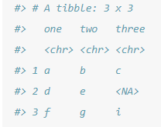
Separating and Pull- Exercises-Refer Video 3
Alternative options for the fill are "right", to fill with missing values from the right, but without a warning
tibble(x = c("a,b,c", "d,e", "f,g,i")) %>% separate(x, c("one", "two", "three"), fill = "right")

Slide 49
Separating and Pull- Exercises-Refer Video 3
2. Both unite() and separate() have a remove argument. What does it do? Why would you set it to FALSE?
The remove argument discards input columns in the result data frame.
If set it to FALSE when to create a new variable, but keep the old one.

Slide 50
Separating and Pull- Exercises-Refer Video 3
3. Compare and contrast separate() and extract(), Why are there three variations of separation (by position, by separator, and with groups), but only one unite?
The function separate(), splits a column into multiple columns by separator, if the sep argument is a character vector, or by character positions, if sep is numeric.
tibble(x = c("X_1", "X_2", "AA_1", "AA_2")) %>% separate(x, c("variable", "into"), sep = "_")
tibble(x = c("X1", "X2", "Y1", "Y2")) %>% separate(x, c("variable", "into"), sep = c(1))
The function extract() uses a regular expression to specify groups in character vector and split that single character vector into multiple columns.
This is more flexible than separate() because it does not require a common separator or specific column positions.

Slide 51
Separating and Pull- Exercises-Refer Video 3
Regex is regular expression
tibble(x = c("X_1", "X_2", "AA_1", "AA_2")) %>% extract(x, c("variable", "id"), regex = "([A-Z])_([0-9])")
Extract() and separate() only one column can be chosen,
but there are many choices how to split that single column into different columns.
With unite(), there are many choices as to which columns to include,
but only one choice as to how to combine their contents into a single vector.

Slide 52
Sub. Topic -Missing Values
A value can be missing in one of two possible ways:
Explicitly, i.e., flagged with NA.
Implicitly, i.e., simply not present in the data.
There are two missing values in this dataset:
The return for the fourth quarter of 2015 is explicitly missing, because the cell where its value should be instead contains NA
The return for the first quarter of 2016 is implicitly missing, because it simply does not appear in the dataset.
stocks <- tibble(
year = c(2015, 2015, 2015, 2015, 2016, 2016, 2016),
qtr = c( 1, 2, 3, 4, 2, 3, 4),
return = c(1.88, 0.59, 0.35, NA, 0.92, 0.17, 2.66)
)

Slide 53
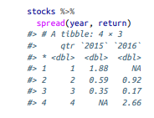
Sub. Topic -Missing Values
The way that a dataset is represented can make implicit values explicit.
For example, the implicit missing value can explicit by putting years in the columns:
stocks%>% spread(year, return)

Slide 54
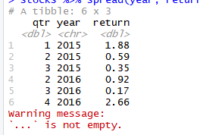
Sub. Topic -Missing Values
If these explicit missing values may not be important in other representations of the data, set na.rm = TRUE in gather() to turn explicit missing values implicit:
stocks %>% spread(year, return) %>% gather(year, return, `2015`:`2016`, na.rm = TRUE)

Slide 55
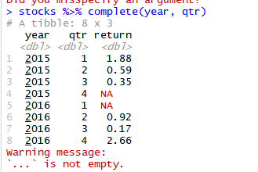
Sub. Topic -Missing Values
Another important tool for making missing values explicit in tidy data is complete():
stocks %>% complete(year, qtr)

Slide 56
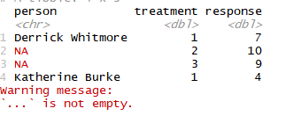
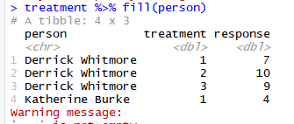
Sub. Topic -Missing Values
Sometimes when a data source has primarily been used for data entry, missing values indicate that the previous value should be carried forward:
treatment <- tribble( ~ person, ~ treatment, ~response, "Derrick Whitmore", 1, 7, NA, 2, 10, NA, 3, 9, "Katherine Burke", 1, 4 )
Fill these missing values with fill().
It takes a set of columns where the missing values to be replaced by the most recent nonmissing value
treatment %>% fill(person)

Slide 57
Missing Values-Exercises
1. Compare and contrast the fill arguments to spread() and complete().
In spread(), all NAs will be replaced by the fill value.
In complete(), NAs under different variables can be replaced by different values.
2. What does the direction argument to fill() do?
With fill, the direction determines whether NA values should be replaced by the previous non-missing value ("down") or the next non-missing value ("up").(Not working in all R version)

Slide 58
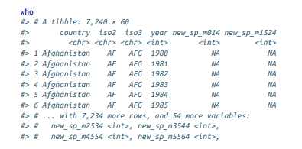
Sub. Topic-Case Study
The tidyr::who dataset contains tuberculosis (TB) cases broken down by year, country, age, gender, and diagnosis method.
The data comes from the 2014 World Health Organization Global Tuberculosis Report
it’s challenging to work with the data in the form that it’s provided

Slide 59
Sub. Topic-Case Study
This is a very typical real-life dataset.
It contains redundant columns, odd variable codes, and many missing values.
The best place to start is almost always to gather together the columns that are not variables.
It looks like country, iso2, and iso3 are three variables that redundantly specify the country
year is clearly also a variable.
There is no clarity that what all the other columns are yet, but given the structure in the variable names (e.g., new_sp_m014, new_ep_m014, new_ep_f014) these are likely to be values, not variables.
So gather together all the columns from new_sp_m014 to newrel_f65.

Slide 60
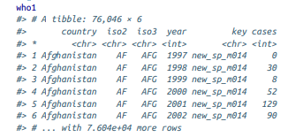
Sub. Topic-Case Study
There is no clarity that, what those values represent yet, so give them the generic name "key".
The cells may represent the count of cases, so use the variable cases.
There are a lot of missing values in the current representation, so use na.rm
who1 <- who %>% gather( new_sp_m014:newrel_f65, key = "key", value = "cases", na.rm = TRUE )
who1

Slide 61
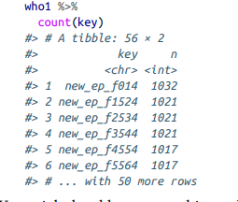
Sub. Topic-Case Study
Get hint of the structure of the values in the new key column by counting them:
who1 %>% count(key)

Slide 62
Sub. Topic-Case Study
The values under key is looking like…
new_sp_m3544“ , "newrel_f65“, “new_sn_f5564”, "new_ep_m4554"
The first three letters of each column denote whether the column contains new or old cases of TB.
In this dataset, each column contains new cases.
The next two letters describe the type of TB:
rel stands for cases of relapse
ep stands for cases of extrapulmonary TB.
sn stands for cases of pulmonary TB that could not be diagnosed by a pulmonary smear (smear negative).
sp stands for cases of pulmonary TB that could be diagnosed be a pulmonary smear (smear positive).

Slide 63
Sub. Topic-Case Study
The sixth letter gives the sex of TB patients. The dataset groups cases by males (m) and females (f).
The remaining numbers give the age group.
The dataset groups cases into seven age groups:
014 = 0–14 years old
1524 = 15–24 years old
2534 = 25–34 years old
3544 = 35–44 years old
4554 = 45–54 years old
5564 = 55–64 years old
65 = 65 or older

Slide 64
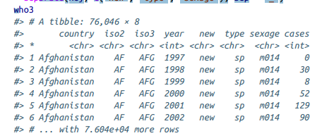
Sub. Topic-Case Study
The names under key column are slightly inconsistent because instead of new_rel we have newrel
So replace the characters “newrel” with “new_rel”.
who2 <- who1 %>% mutate(key = stringr::str_replace(key, "newrel", "new_rel"))
Separate the values in each code with two passes of separate().
The first pass will split the codes at each underscore:
who3 <- who2 %>% separate(key, c("new", "type", "sexage"), sep = "_")
who3

Slide 65
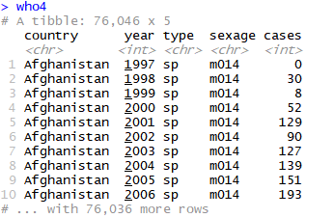
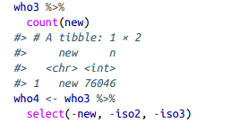
Sub. Topic-Case Study
Then drop the new column because it’s constant in this dataset.
While dropping columns, let’s also drop iso2 and iso3 since they’re redundant
who4 <- who3 %>% select(-new, -iso2, -iso3)

Slide 66
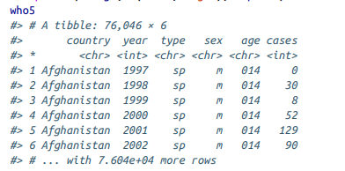
Sub. Topic-Case Study
Now separate sexage into sex and age by splitting after the first character:
who5 <- who4 %>% separate(sexage, c("sex", "age"), sep = 1)
who5
The who dataset is now tidy!

Slide 67
Sub. Topic-Case Study
Complete Code to make who data set into a tidy one :
who
names(who)
who1 <- who %>% gather( new_sp_m014:newrel_f65, key = "key", value = "cases", na.rm = TRUE )
who1
who2 <- who1 %>% mutate(key = stringr::str_replace(key, "newrel", "new_rel"))
who3 <- who2 %>% separate(key, c("new", "type", "sexage"), sep = "_")
who3
who4 <- who3 %>% select(-new, -iso2, -iso3)
who4
who5 <- who4 %>% separate(sexage, c("sex", "age"), sep = 1)
who5

Slide 68
Sub. Topic-Case Study
A complex pipe code :
who %>%
gather(code, value, new_sp_m014:newrel_f65, na.rm = TRUE) %>%
mutate(
code = stringr::str_replace(code, "newrel", "new_rel")
) %>%
separate(code, c("new", "var", "sexage")) %>%
select(-new, -iso2, -iso3) %>%
separate(sexage, c("sex", "age"), sep = 1)

Slide 69
Case Study-Exercises
1. In this case study I set na.rm = TRUE just to make it easier to check that we had the correct values. Is this reasonable? Think about how missing values are represented in this dataset. Are there implicit missing values? What’s the difference between an NA and zero?
na.rm = TRUE is reasonable since it select only complete rows
0 is used to represent no cases of TB.
Explicit missing values (NAs) are used to represent missing data for (country, year) combinations in which the country existed in that year.
Implicit missing values are used to represent missing data because a country did not exist in that year.

Slide 70
Case Study-Exercises
2. What happens if you neglect the mutate() step? (mutate(key = stringr::str_replace(key, "newrel", "new_rel"))).
The observations with the value as newrel will get omitted when use seperate() function.
The warning “too few values”. will occur when use separate() function

Slide 71
Case Study-Exercises
3. I claimed that iso2 and iso3 were redundant with country. Confirm this claim.
iso2 and iso3 contain the 2- and 3-letter country abbreviations for the country.
So, iso2 and iso3 are redundant with country

Slide 72
Case Study-Exercises
4. For each country, year, and sex compute the total number of cases of TB. Make an informative visualization of the data.
who5 %>% group_by(country, year, sex)%>%
summarise(cases = sum(cases)) %>%
ggplot(aes(x = year, y = cases, group = country, colour = sex)) + geom_line()

Slide 73
Sub. Topic-Nontidy Data
There are two main reasons to use non tidy data:
Alternative representations may have substantial performance or space advantages.
Specialized fields have evolved their own conventions for storing data that may be quite different to the conventions of tidy data.
Tidy data should be default choice. But there are good reasons to use other structures; tidy data is not the only way.

Slide 74
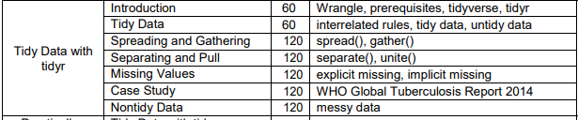
Summary

